Slide 1



Control Panel Circuit Board
MEMSDuino
Lafe Spietz
NIST
2024

Slide 2
Abstract
This is the control panel, where a human operator pushes buttons to set the state of the switch and can see indicator lights which display the state of the switch. Indicator lights are programmable RGB LED’s and buttons connect an analog pin on the Arduino to a resistor ladder.
MEMSDuino

Slide 3
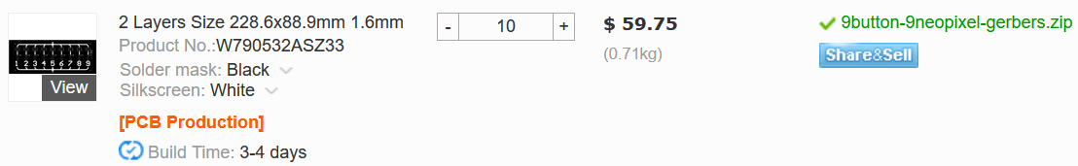
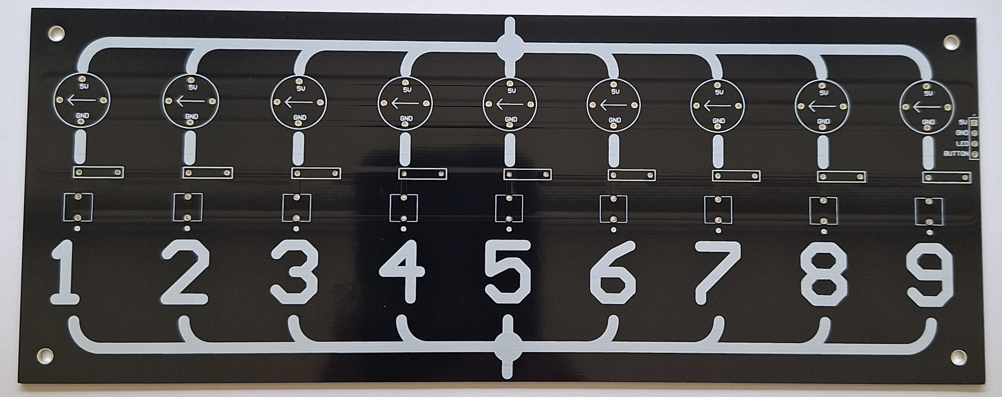
Order Circuit Boards
228.6 x88.9 mm size
Black solder mask
White silkscreen
1.6mm FR4
https://www.pcbway.com/
9button-9neopixel
https://github.com/lafefspietz/MEMSduino/raw/main/PCB_files/9button-9neopixel-gerbers.zip
MEMSDuino

Slide 4
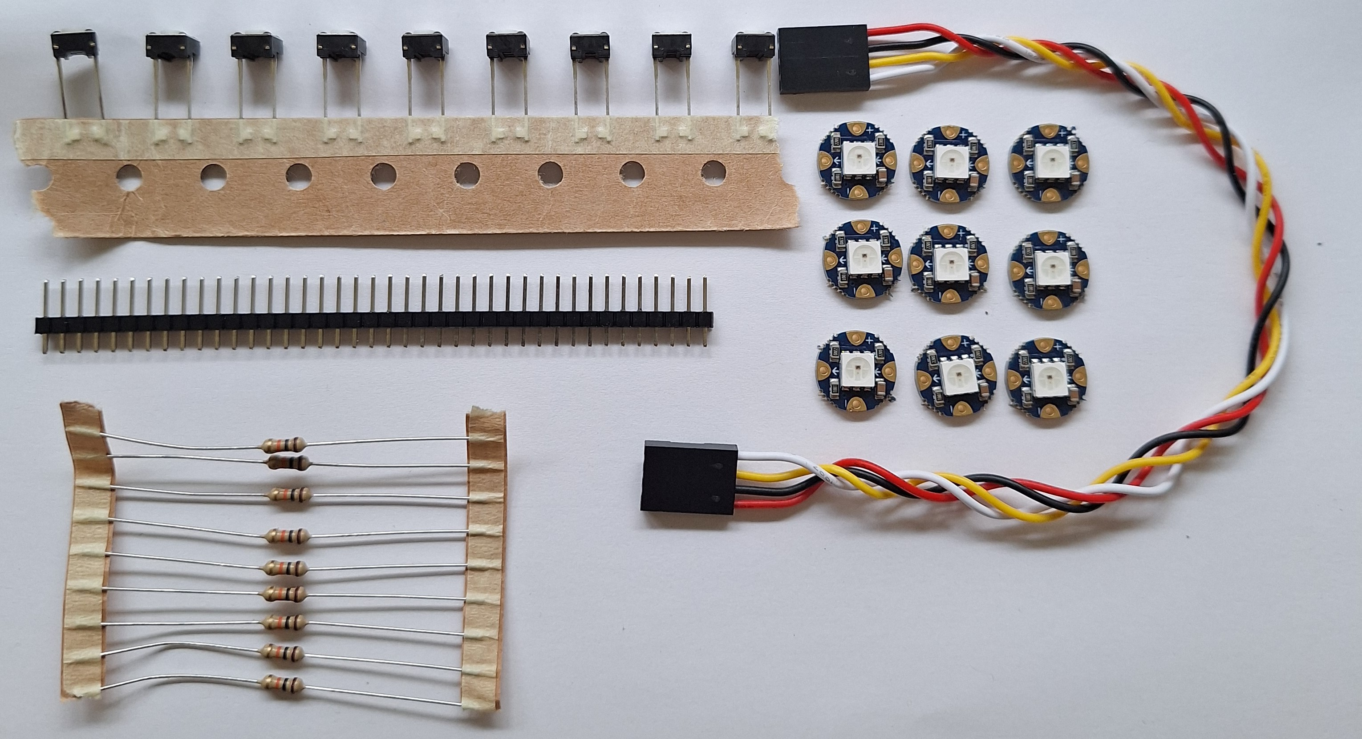
Order Components
4 Wire Header cable, 6” long x1
Button x9
https://www.amazon.com/ZYAMY-Dupont-Connector-Multicolor-Breadboard/dp/B0789F523N/
https://www.digikey.com/en/products/detail/e-switch/TL59NF160Q/390533
10 kOhm axial resistor x9
NeoPixel RGB programmable LED x9
https://www.digikey.com/en/products/detail/yageo/MFR-25FBF52-10K/13219
https://www.adafruit.com/product/1559
MEMSDuino

Slide 5
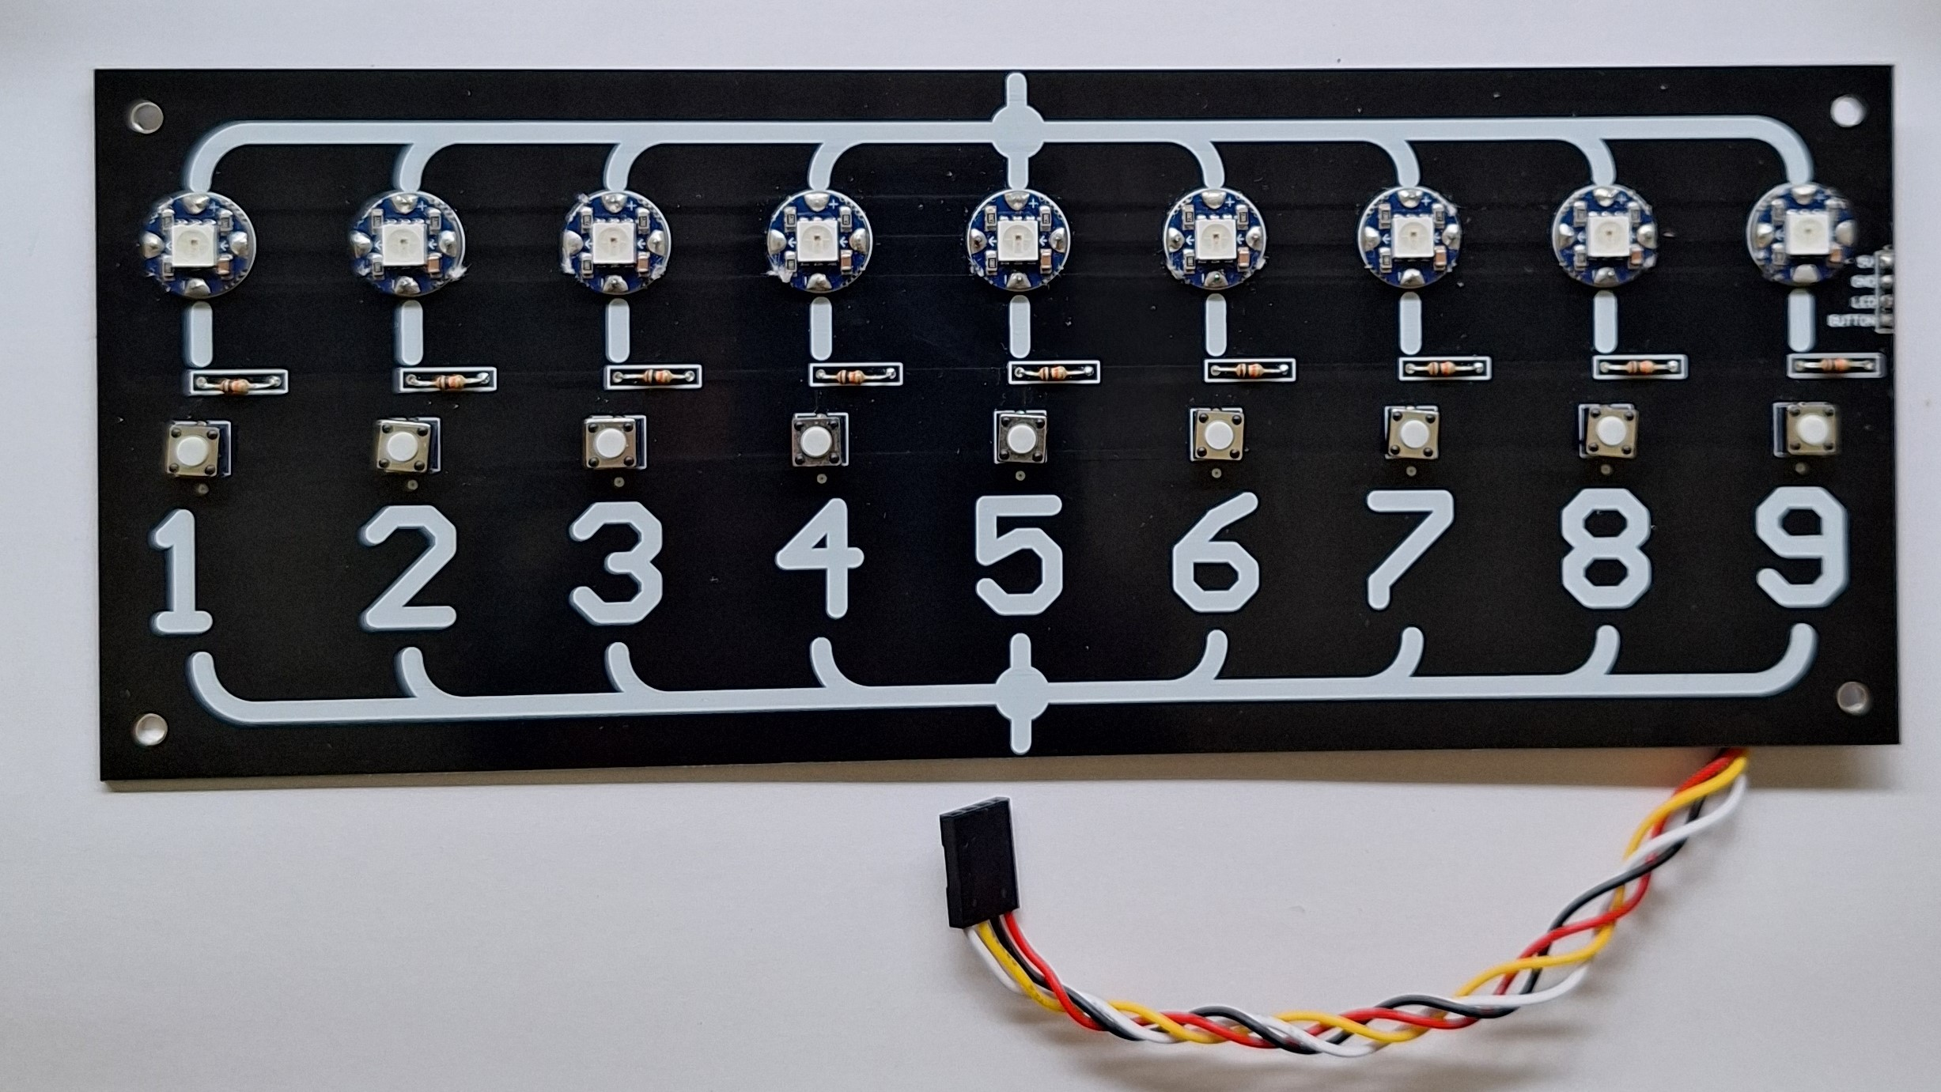
Assembly
MEMSDuino

Slide 6
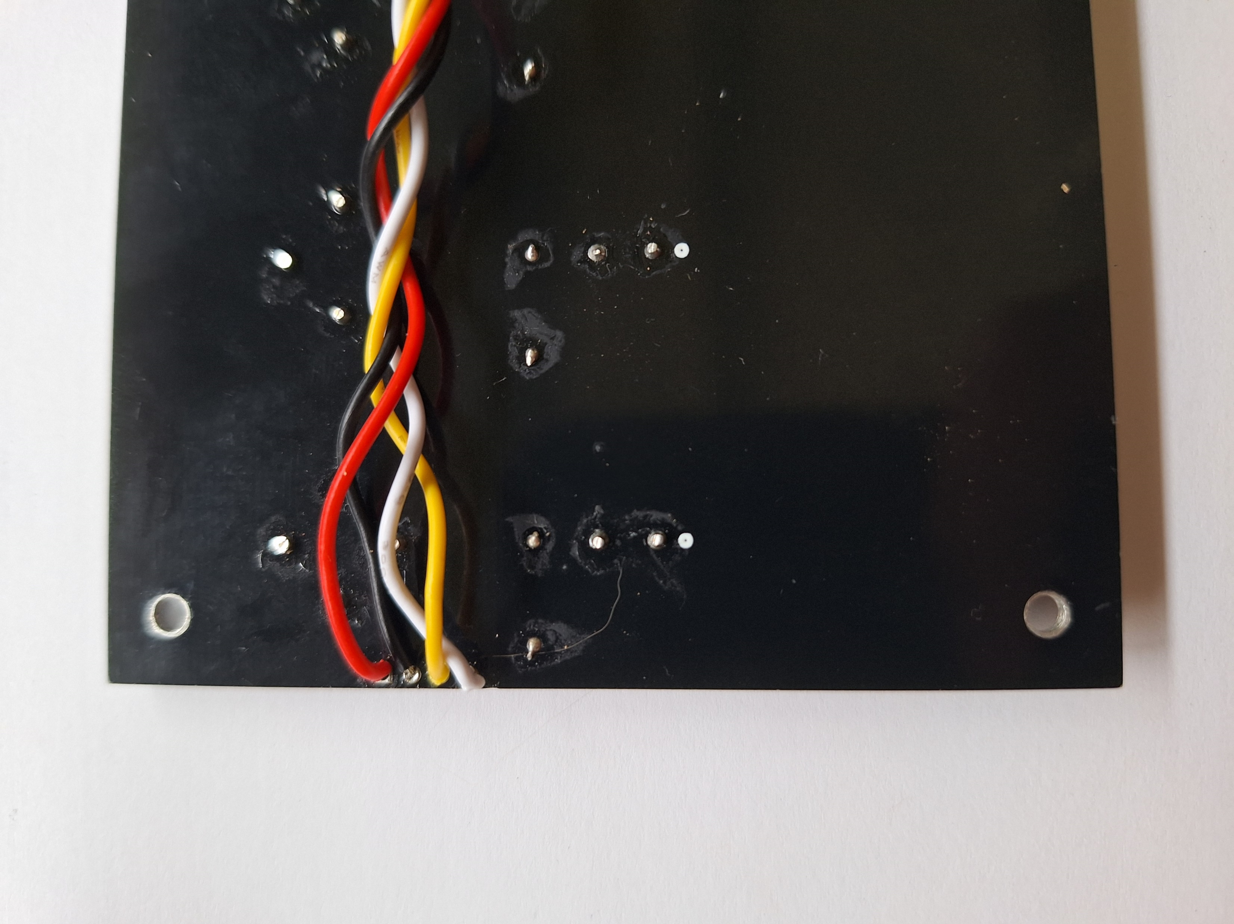
Backside Detail of cable connection
MEMSDuino

Slide 7
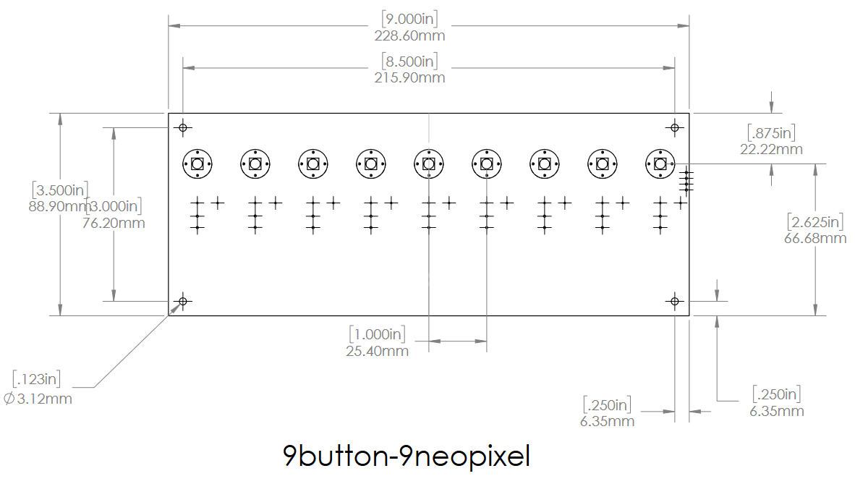
Dimensioned Drawing
MEMSDuino

Slide 8
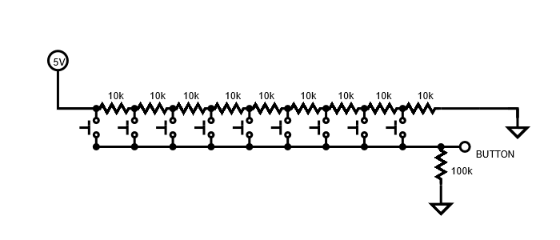
Button Ladder Schematic
Buttons connect analog line A4 on the Arduino to different nodes in a ladder of resistors which spans from 5 volts to a node just above ground. The analog line has a 100k pull down resistor on the Arduino Shield Circuit Board.
MEMSDuino

Slide 9
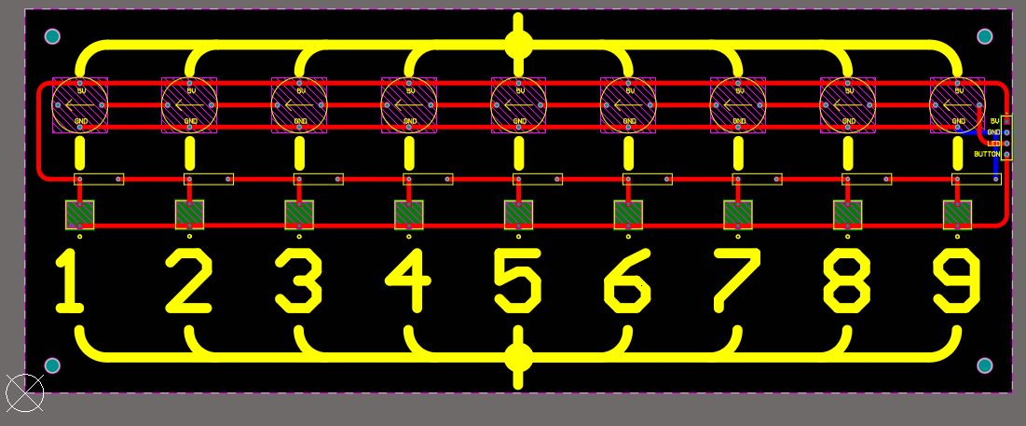
PCB Layout
Created in Altium Designer
MEMSDuino

Slide 10
Conclusions:
This board should get either replaced by or integrated into panels like the ones from frontpanelexpress.com for a more professional finish. These are cheaper and easier to rapid prototype, however.
MEMSDuino

